Slide 1
Internship Project
Name : Abhiyank Goyal
Program : T.Y. B-Tech, CSE, trimester - IX
PRN No. : 1032170652
Company : Simption Tech. Pvt. Ltd.
Project Title : Student Registration System
(School Software System)

Slide 2
Objectives
To Design online Student Registration System for Schools/Colleges which will ease the work of administrator to maintain the record of students and speed up the admission process of the students.
The project includes a sign-up form for the organization to assign the new administrator.
It consists of login form where admin can login.
It includes a form that allows admin to enter student details like:
Registration No.(which is automatically generated to remove duplicacy)
Select if Student is new/old
Class
Student name

Slide 3
Objectives
Gender
Date of admission
Bus service
Registration fees
Student’s address
Student photo
Student’s parent details
And other important details

Slide 4
Objectives
On click of the submit button, the page should be validated and after successful validation the data must be saved in the database.
The admin should be directed to the page where he can view the list of all the students registered
Each student should have options to:
Modify the details of the student
Delete the record of the student
Print receipt
Make Admission

Slide 5
Objectives
On click of modify option a page should open to where admin can make changes to the details of the student.
On click of delete option, the student record must be deleted from the list.
On click of Make Admission button a page must open showing the details of the student and options to upload various identification documents.
Once the documents are uploaded the user should be able to save the documents to the server and directed to the page where the list of all the students admitted is displayed. Here also each student has the options to modify, delete and print receipt.

Slide 6
Background
The current system in the schools/colleges of rural areas of India is a manually operated system where new student is registered manually in a register where registration no., student name and other details are recorded. The school uses manual system in the process of administration and all its data is maintained in the files.
After the student is registered, the person in charge of admission has to count the no. of students manually. All this work is tedious and also wastage of time.
Also to search any student in this type of system is very hectic and time consuming work.
In the proposed system the administrator will be able to login to the application and can register new students and can also track information of the student which will sped up the admission process of the student.

Slide 7
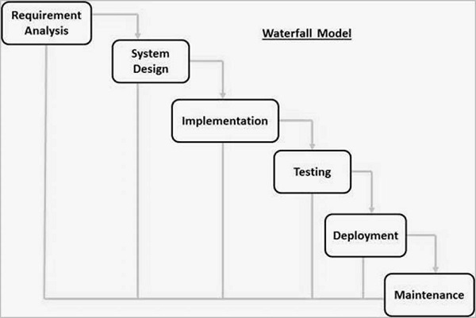
Methodology followed
Used Waterfall Method:
The waterfall Model illustrates the software development process in a linear sequential flow. This means that any phase in the development process begins only if the previous phase is complete. In this waterfall model, the phases do not overlap.

Slide 8
The Waterfall method
The sequential phases in Waterfall model are −
Requirement Gathering and analysis − All possible requirements of the system to be developed are captured in this phase and documented in a requirement specification document.
System Design − the requirement specifications from first phase are studied in this phase and the system design is prepared. This system design helps in specifying hardware and system requirements and helps in defining the overall system architecture.
Implementation − with inputs from the system design, the system is first developed in small programs called units, which are integrated in the next phase. Each unit is developed and tested for its functionality, which is referred to as Unit Testing.
Integration and Testing − All the units developed in the implementation phase are integrated into a system after testing of each unit. Post integration the entire system is tested for any faults and failures.
Deployment of system − Once the functional and non-functional testing is done; the product is deployed in the customer environment or released into the market.
Maintenance − There are some issues which come up in the client environment. To fix those issues, patches are released. Also to enhance the product some better versions are released. Maintenance is done to deliver these changes in the customer environment.
All these phases are cascaded to each other in which progress is seen as flowing steadily downwards (like a waterfall) through the phases. The next phase is started only after the defined set of goals are achieved for previous phase and it is signed off, so the name "Waterfall Model". In this model, phases do not overlap.

Slide 9
Tools and technologies used
The project is developed using following frameworks:
HTML5
CSS
JavaScript
AJAX
PHP
MySQL

Slide 10
Tasks Completed
Gathered project requirements
Details necessary for registering a student
Frameworks and technologies to be used
Designed a Sign-up and login page with the help of html5 and CSS.
Validated the Sign-up and login form with the help of JavaScript and server side language PHP using MySQL database.
Designed a Registration Form with the help of html5 and CSS.

Slide 11
Tasks Completed
Persisted the Student details in the MySQL database using PHP and performed validation using JavaScript. Generated unique registration for each new student.
Designed the students list page which consists a list of all the students registered and given options to modify the details, make admission, print receipt and delete the record to each student.
Implemented functionality to allow admin to modify, make admission and delete the record of the registered student.

Slide 12
Tasks Completed
Designed the page to modify the student details and performed the update query in the database using PHP.
Designed and styled a page to upload various documents required for the admission.
Stored the uploaded documents at the server side using JavaScript and PHP.
Designed and styled a page of admitted students which shows the list of all the students admitted. It has options to modify, delete the record of the student and print the admission fee receipt.

Slide 13
Tasks Completed
All the pages are given the navigation menu so that admin can navigate between different pages.
Below are the screenshots of the work:

Slide 14
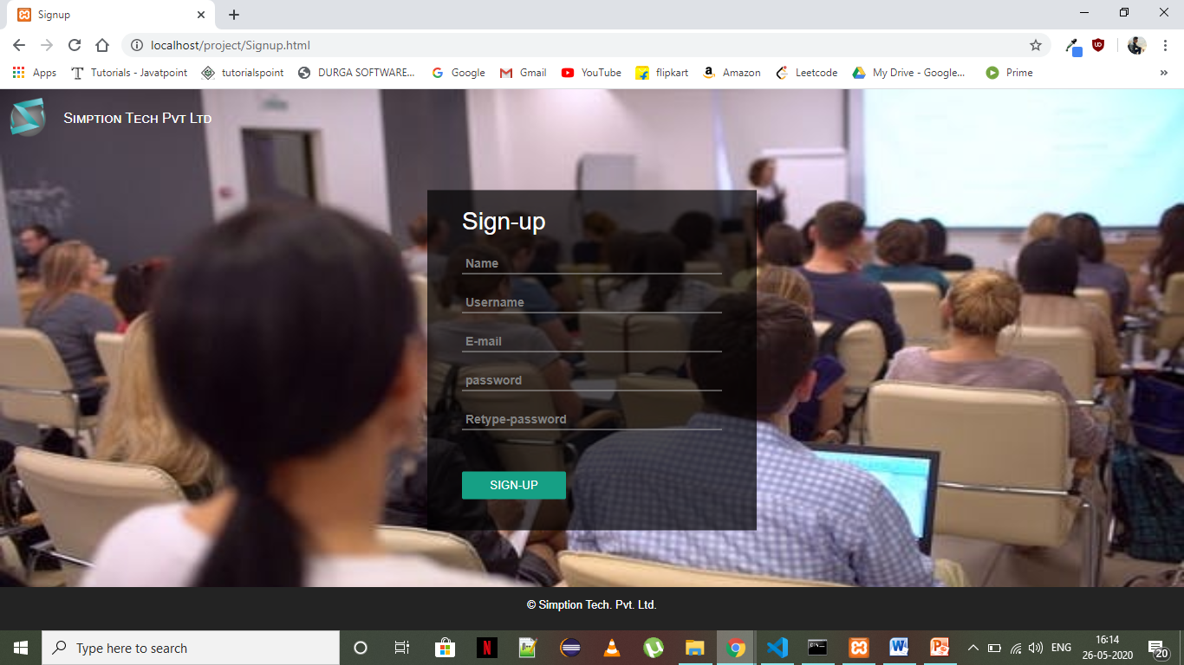
Sign-Up Page

Slide 15
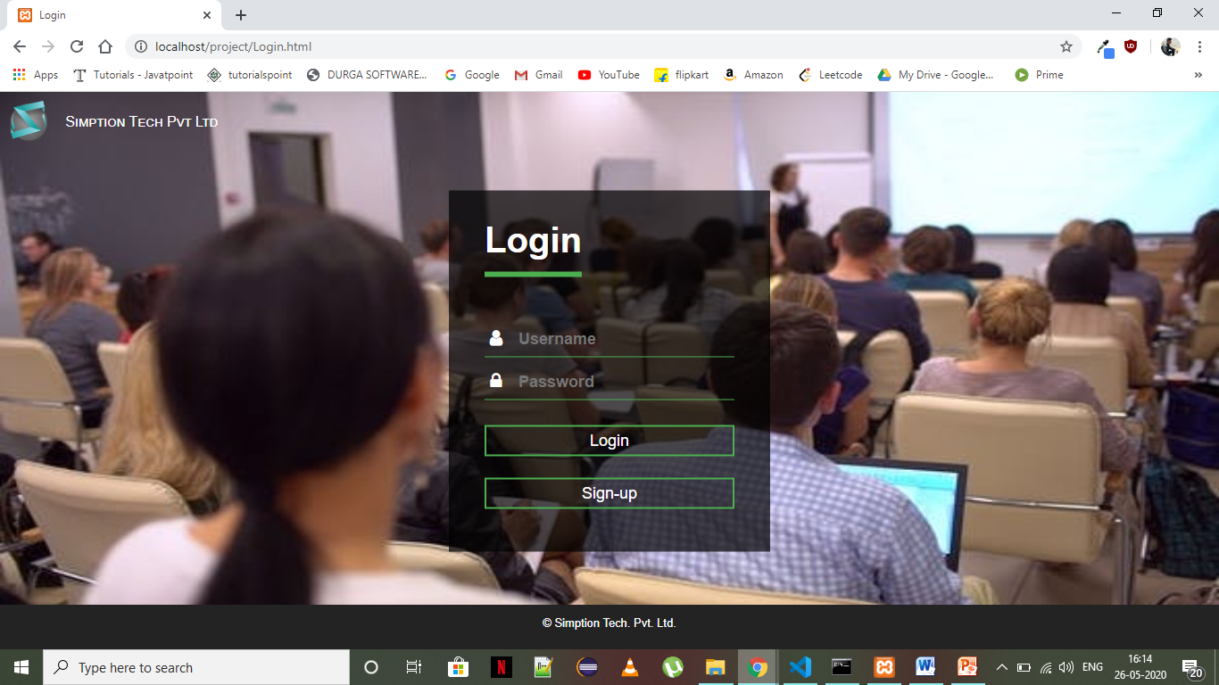
Login Page

Slide 16
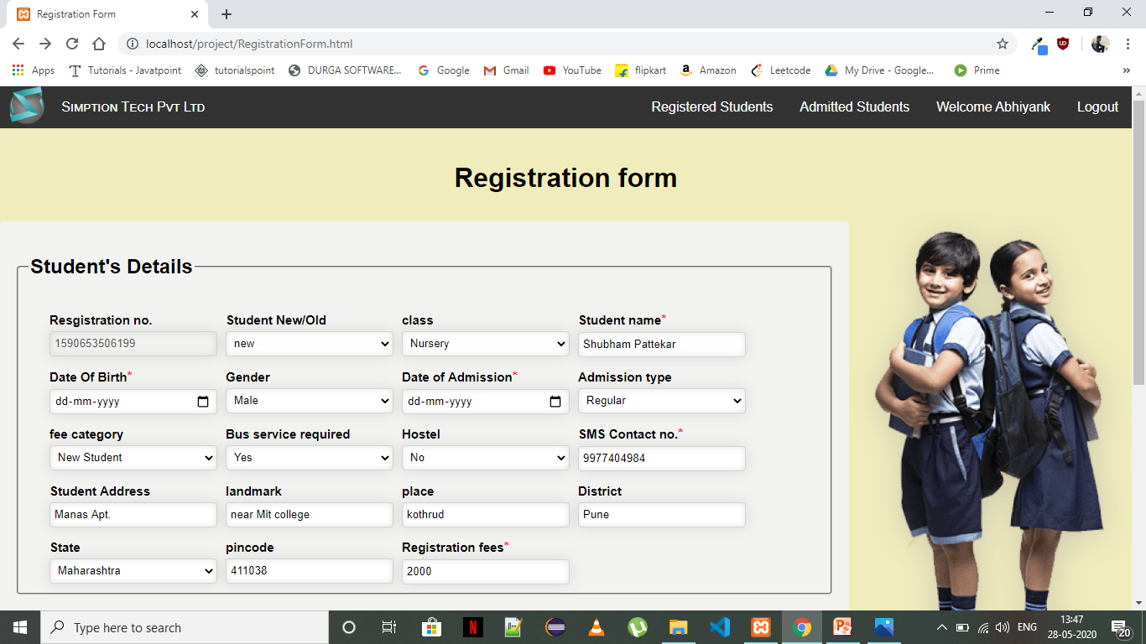
Registration Form

Slide 17
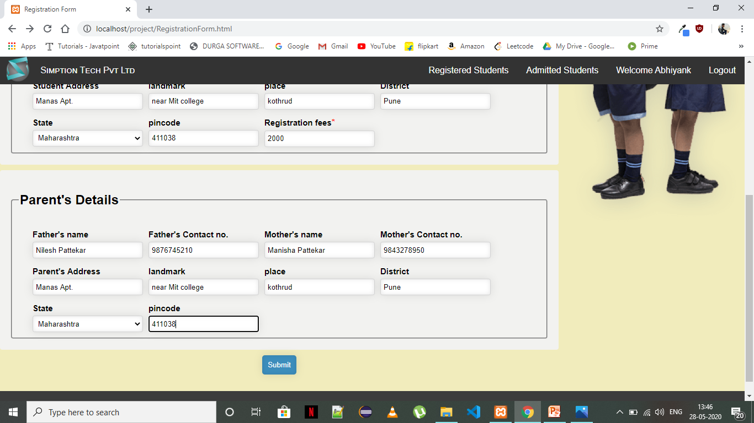

Slide 18
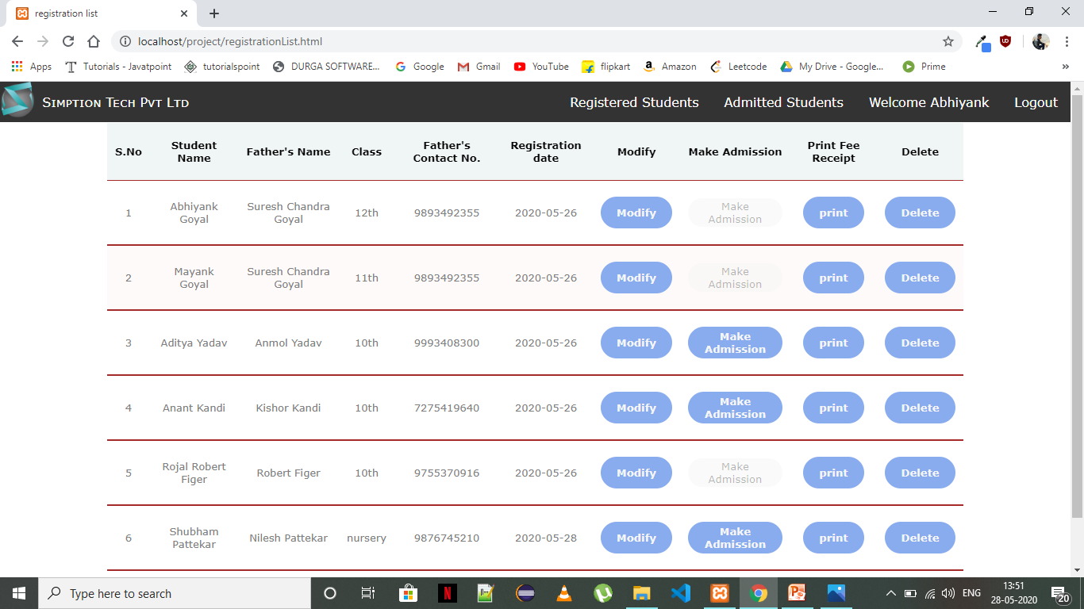
Registered Students list page

Slide 19

Update Student Details page

Slide 20
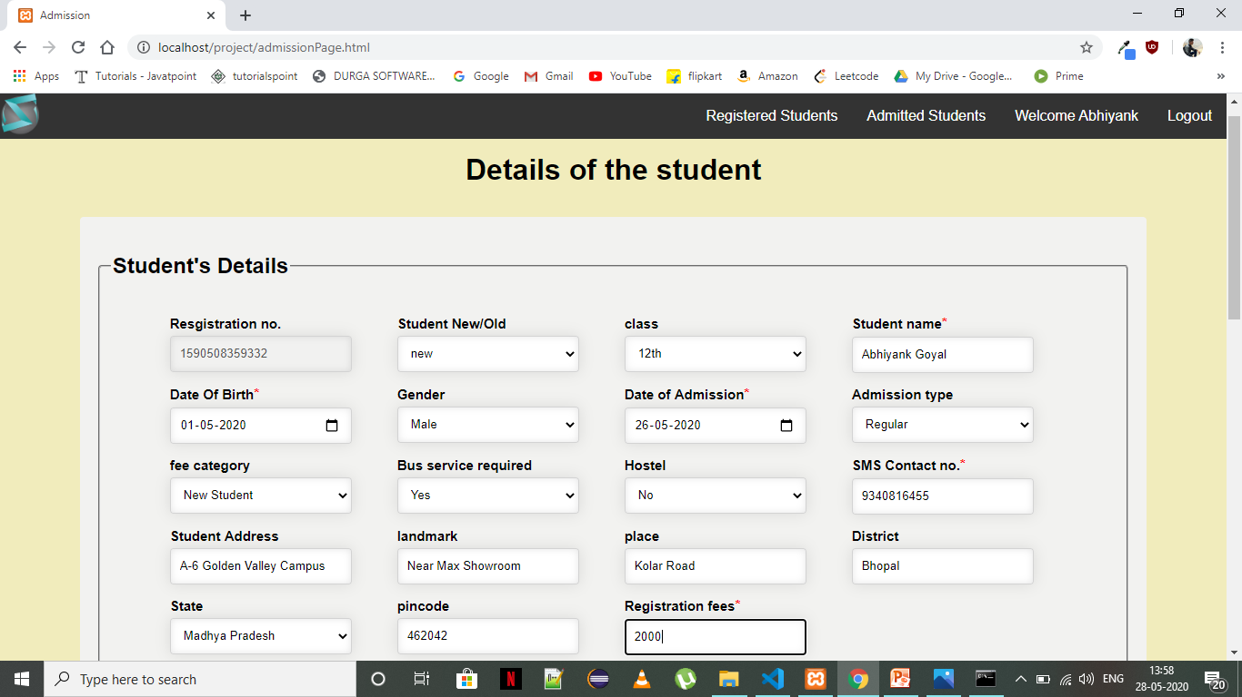
Documents upload page

Slide 21
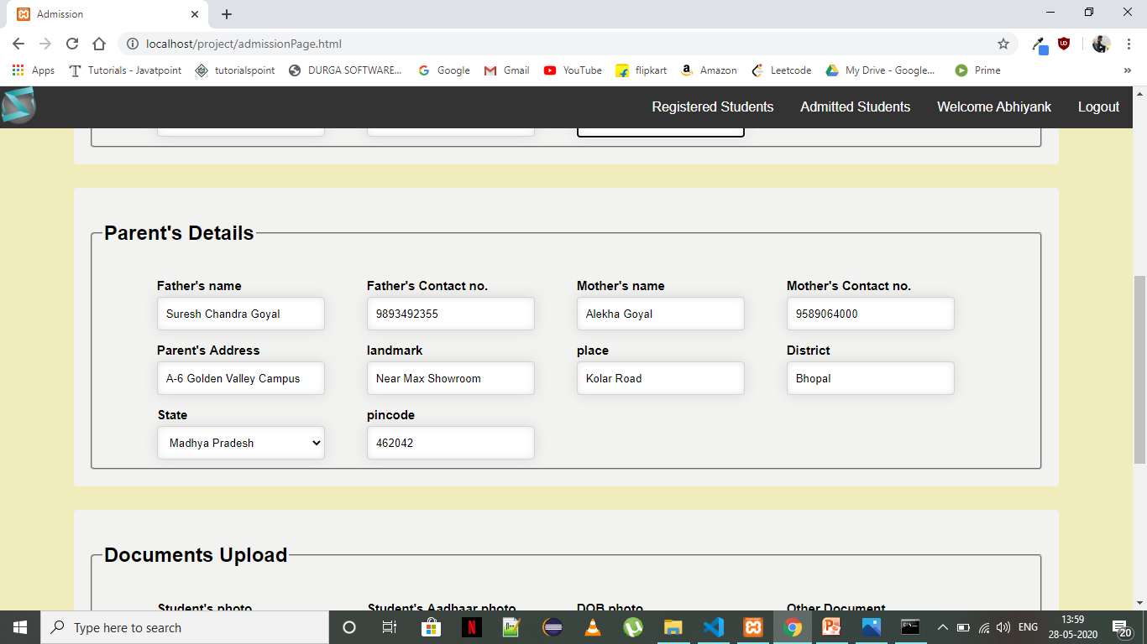

Slide 22
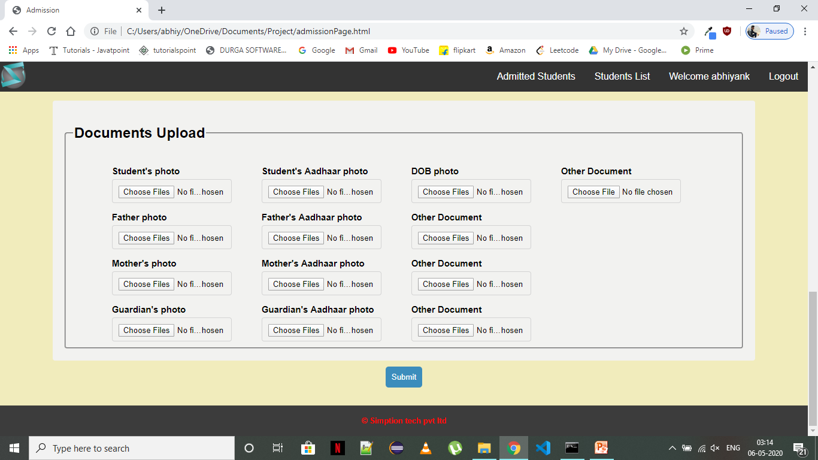

Slide 23
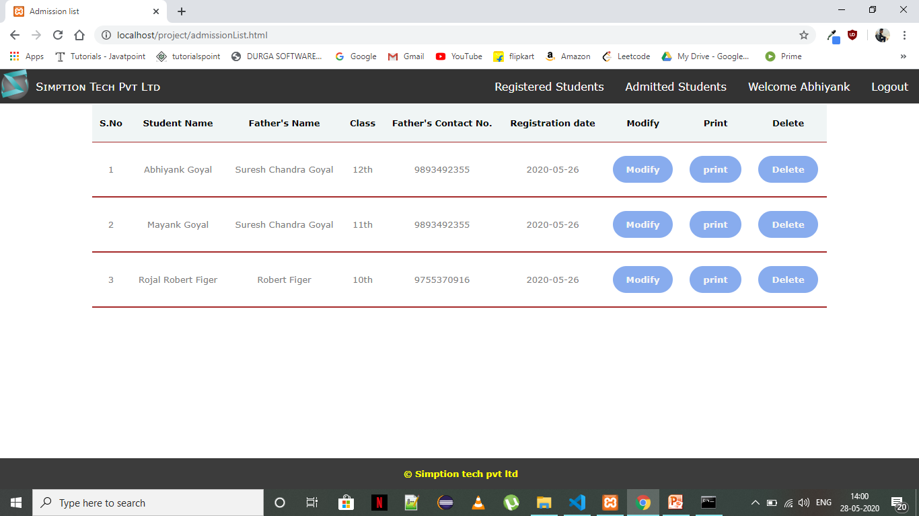
Admitted Students page

Slide 24
Conclusions
Successfully used HTML5, CSS, JavaScript, AJAX, PHP, and MySQL to store the information of the student in the database. Learnt the use of different tools and technologies to resolve the real world problems.
Used HTML5 to design the content the content of the web pages
Used CSS to style the pages and make the pages responsive.
Used JavaScript to set the behaviour of the application.
Used AJAX to exchange the data from the php and the database.
Used PHP to insert data into the database and perform operations on the data
Used MySQL to create database to store data and perform various operations on it.

Slide 25
Key Learning's till date
Understanding of attributes required to register a student or make an admission for him.
Able to use html5 to design structure of a given web application
Using CSS to style the web application
Understanding how CSS helps in creating responsive web design.

Slide 26
Key Learning's till date
Training on JavaScript.
learned how to describe functionality of the web pages through JavaScript.
Learned how to apply form validation using JavaScript.
Learned to use local storage and session storage of the browser to store data and use that data.

Slide 27
Key Learning's till date
Learned the server side language PHP.
Learned to make data persistent in MySQL database PHP.
Learned the use of AJAX to make data exchange between the back-end and the front end.

Slide 28
Thank You

